Slide 1
Who Am I?
Behavioural Styles
Notes:
To be a leader you need followers.
What if you are unknowingly putting some people off?
What if you are interacting with them in ways that get their backs up or stop you getting the best out of them?

Slide 2
Behavioural Styles
1960s - David Merrill and Roger Reid (industrial psychologists)
Their BIG question:
Could managerial, leadership and sales performance be predicted?
They studied:
How people behave in social situations.
They found:
People’s behaviour follows two continua
Assertiveness and Responsiveness.
A.K.A. Push and Pull
Their Behavioural Styles focus on outer behaviour, rather than the inner you.
‘the you that’s on display’.
Reference to Merrill & Reid (1999)
Notes:
Background to Merrill and Reid’s model
In the early 1960s, two industrial psychologists, David Merrill and Roger Reid wanted to understand whether they could predict managerial, leadership and sales performance. To do this, they explored how people behave in social situations. They chose not to concern themselves with why.
Combining Skinner’s ideas of behaviourism and James Taylor’s structured list of behavioural descriptions, Merrill and Reid discovered that people’s behaviour follows two continua, which they labelled: assertiveness and responsiveness.
Their Social Styles are a model of personality that focuses on our outer behaviour, rather than the inner you. Merrill and Reid described it as ‘the you that’s on display’.
Styles Quadrant
Horizontal axis = Easy going to Dominant
Vertical Axis = Spontaneous to Self Controlled

Slide 3
Behavioural Styles
Spontaneous
Amiable
Expressive
Easy Going
Dominant
Analyst
Driver
Self-controlled
Reference to Merrill & Reid (1999)
Notes:
Explain the Styles Quadrant
Horizontal axis = Easy going to Dominant
Vertical Axis = Spontaneous to Self Controlled
Briefly explain the titles for each quarter of the quadrant.
Don't give too much as you will give a fuller briefing in a minute.
EG:
“If someone is spontaneous and easy going, in Merrill and Reid's model they are categorised as “Amiable” And so on.”

Slide 4
Behavioural Styles
Amiable
Expressive
“I like …”
“I feel …”
Let’s do it together
Let’s do it with some fun
A balanced disposition; a pleasing personality; promoter of harmony; loyal to team and friends; genuine concern for people
The ability to talk about anything, anywhere, any time (with or without information); a sense of humour and optimism; a bubbly personality
Analyst
Driver
“I think …”
“I know …”
Let’s do it the right way
Let’s do it my way
The ability to organise, to set long-term goals; the holding of high standards and ideals; a strong sense of duty; an ability to analyse
Directness; the ability to quickly take charge and make decision; a focus on achieving the task; a willingness to take risks; not easily discouraged
Reference to Merrill & Reid (1999)
Notes:
Each described by how they like to do things, a thought-bubble and some behavioural characteristics.

Slide 5
We possess all four styles
All four approaches are at our disposal.
We default to one style.
Our predominant style can be described by:
What I find interesting
What I feel is important
My usual behaviour under normal conditions
Behaviour is not personality
All styles have evil twins
There is no best or worst style
Notes:
While all four approaches are at the disposal of each and every individual, there is a tendency for most of us to develop one approach more than the other three.
The predominant style can be described by:
what the individual finds of interest
what the individual feels is important
their behaviour or actions
Whilst an individual may dip in and out of all four approaches, most of us tend to favour one approach more than the other three. We tend to have a predominant style and a least used style.

Slide 6
Can you write your name?
Notes:
WRITE YOUR NAME
NOW TRY OTHER HAND
Ask what felt “normal” comfortable.
If you broke your writing hand could you write?
YES – although it is unfamiliar, you could still do it and probably with time get good at it.
But as soon as your usual hand was healed you’d revert back.
That’s how it is with the personality styles.
We have all the types but over time have a preference for the way we usually are.
So we can be different if we want to.

Slide 7
Behavioural Styles
Spontaneous
Amiable
Expressive
Easy Going
Dominant
Analyst
Driver
Self-controlled
Reference to Merrill & Reid (1999)

Slide 8
Analyst (Tecnician)
Characteristics
Formal, measured and systematic
Seeks accuracy and precision
Dislikes unpredictability and surprise
Are well organised and thorough
Places high value on facts, figures, data and reason.
Others describe their actions as systematic and methodical.
Tend to follow an orderly approach in tackling a task
May be perceived as
too cautious and overly structured
doing things too much ‘by the book’.

Slide 9
Analyst (Technician)
Good at:
Analysing past data
Considering the present situation
Projecting facts for planning purposes
Being thorough
Critical thinking
Attention to detail

Slide 10
Behavioural Styles
Spontaneous
Amiable
Expressive
Easy Going
Dominant
Analyst
Driver
Self-controlled
Reference to Merrill & Reid (1999)

Slide 11
Amiable (Relationality)
Characteristics
Conforming, unrushed and easy going
Seeks appreciation between others
Dislikes insensitivity and impatience
Places high value on personal relationships, feelings, human interactions and affiliation with others.
May be perceived as:
warm and sensitive to the feelings of others.
perceptive, able to assess a situation in terms of the human emotions
a loyal and supportive friend.
too emotional, sentimental and too easily swayed by others.

Slide 12
Amiable (Relationality)
Good at:
Helping others
Listening
Flexible working with others
Learning from past events
Loyalty and stickability
Bringing fun and building team spirit

Slide 13
Behavioural Styles
Spontaneous
Amiable
Expressive
Easy Going
Dominant
Analyst
Driver
Self-controlled
Reference to Merrill & Reid (1999)

Slide 14
Expressive (Social Creative)
Characteristics
Flamboyant, fast and spontaneous.
Seeks recognition.
Dislikes routine and boredom.
Interested in taking people with them.
Able to enthuse people with optimism and energy.
Open and willing to make personal investment.
When others don’t catch the wind, can feel personally let down.
May be perceived as:
“Scary” - over-dominant and enthusiastic.
Poor with detail and too willing to go with hunches

Slide 15
Expressive (Social Creative)
Good at:
Inspiring others
Being persuasive
Enthusiasm
Working with people and at running projects
Being creative and coming up with ideas

Slide 16
Behavioural Styles
Spontaneous
Amiable
Expressive
Easy Going
Dominant
Analyst
Driver
Self-controlled
Reference to Merrill & Reid (1999)

Slide 17
Driver (Commander)
Characteristics
Business like, fast and decisive; Seeks control
Dislikes inefficiency and indecision
Places great emphasis on action and results.
Time orientation is here and now
Likes to get things done - hates spinning things out.
Are dynamic and resourceful
May be perceived as:
Decisive, direct and pragmatic.
Focused on the short term and neglecting long term implications.
Impulsive and simplistic - acting before thinking

Slide 18
Driver (Commander)
Good at:
Translating ideas into action
Getting things moving & overcoming resistance
Being decisive
Getting things done
Being tough minded

Slide 19
Guess your style
Amiable
Expressive
“I like …”
“I feel …”
Let’s do it together
Let’s do it with some fun
A balanced disposition; a pleasing personality; promoter of harmony; loyal to team and friends; genuine concern for people
The ability to talk about anything, anywhere, any time (with or without information); a sense of humour and optimism; a bubbly personality
Analyst
Driver
“I think …”
“I know …”
Let’s do it the right way
Let’s do it my way
The ability to organise, to set long-term goals; the holding of high standards and ideals; a strong sense of duty; an ability to analyse
Directness; the ability to quickly take charge and make decision; a focus on achieving the task; a willingness to take risks; not easily discouraged
Reference to Merrill & Reid (1999)
Notes:
Guess Your Style
Delegates to guess from the information they just heard which style best describes their usual behaviour.
Then ask people to refer to the questionnaire they should have done before the course.

Slide 20
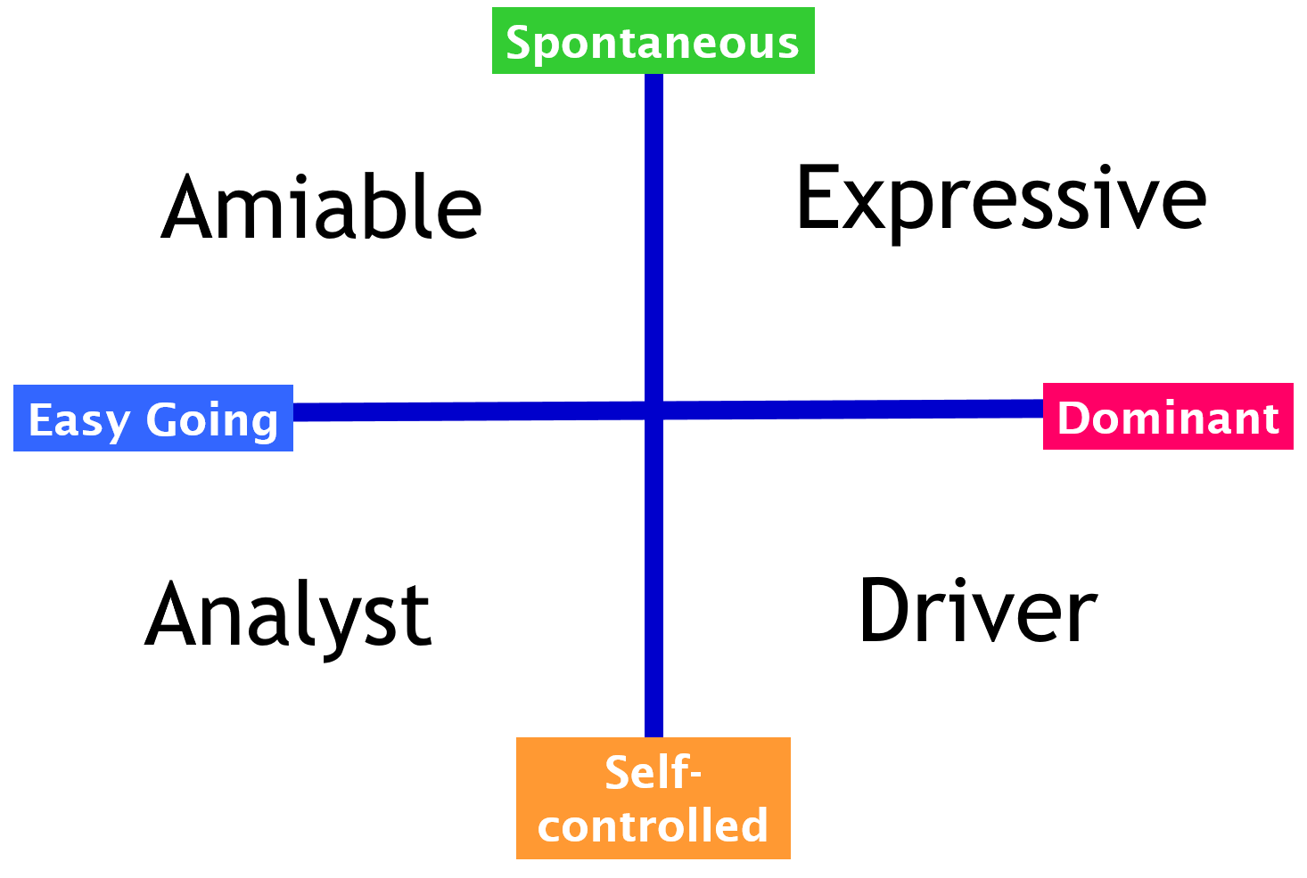
What’s your behavioural style?
Match your guess with your questionnaire
Which style is your predominant one?
Notes:
What’s your behavioural Style?
Add the guess with the result and they decide what style they mostly demonstrate through behaviour and language.

Slide 21
Understanding my style
Share with your colleague:
This is my style and this is how it describes my behaviour …
This is what’s good about my style ….
What I need to watch out for and what my blind spots are …
What this means for my role leading others is ….
Notes:
Pairs work – understanding my type

Slide 22
Behavioural Styles
Amiable
Expressive
“I like …”
“I feel …”
Let’s do it together
Let’s do it with some fun
A balanced disposition; a pleasing personality; promoter of harmony; loyal to team and friends; genuine concern for people
The ability to talk about anything, anywhere, any time (with or without information); a sense of humour and optimism; a bubbly personality
Analyst
Driver
“I think …”
“I know …”
Let’s do it the right way
Let’s do it my way
The ability to organise, to set long-term goals; the holding of high standards and ideals; a strong sense of duty; an ability to analyse
Directness; the ability to quickly take charge and make decision; a focus on achieving the task; a willingness to take risks; not easily discouraged
Reference to Merrill & Reid (1999)
Notes:
Each described by how they like to do things, a thought-bubble and some behavioural characteristics.

Slide 23
Style Buddies
With your style buddies, consider the following questions
How do you behave under intense pressure?
What are your initial reactions to significant change that affects you?
Note down the common themes to share with the rest of us
Notes:
Sharing understanding
SET UP: Set up space at the 4 corners of the room.
Each corner has one of the styles on flipchart pinned to wall.
People get with others who have a similar style.
Group task (10 minutes)
1. How do you behave under intense pressure?
2. How do you respond to major change?
NOTE: You will observe the behaviours of the styles in the way this is done. Expressives will be loud and animated and fill the paper in 5 minutes. Drivers will get on with the job diligently - possibly vying for control. Analysists are likely to analyse the questions before starting. Amiables will take ages to get going – making sure everyone feels OK and included.
When the groups have done 10 minutes tell them what you observed in terms of behaviour of the groups and how each did the activity.
Feedback
Each group tells the others their answers.

Slide 24
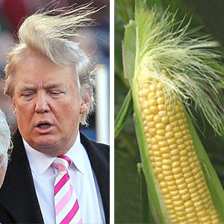
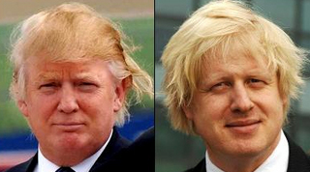
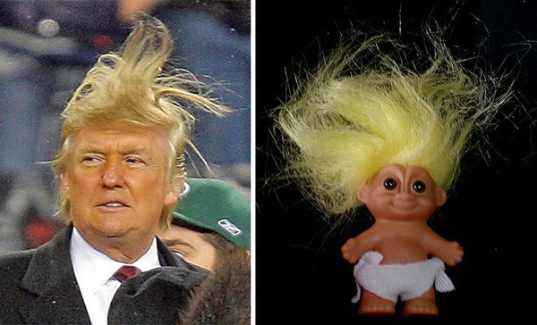
If only people were like me!
Notes:
Using personal styles when working with individuals, it is important to consider his or her needs and styles.
You also need to be aware of your own style and biases and try to understand and relate to those who may have styles that are different to yours
To get more followers – be versatile.

Slide 25
Versatility
Most people’s social preferences are different to yours.
Tension happens because of difference
It is a stimulus that causes us to act rather than to remain inactive
Even if we’re in our comfort zones, our behaviour might be creating tension for someone else
The key to successful and fruitful relationships:
Understand the preferences of the people you interact with
Adjust your behaviour accordingly.
A high level of versatility means:
Turn down your default
Turn up your less used styles
THE KEY TO SUCCESS IN PERSONAL RELATIONSHIPS:
Not to treat others how you would like to be treated 
Treat others how they would like to be treated 

Slide 26
Weaknesses and Strengths
Amiable
Expressive
ALL ARE GOOD AT
Planning
Meeting deadlines
Being innovative
Caring for people
Being task focused
Excellent standards
Meeting challenges
Analysis
Conforming
Unsure
Pliable
Dependent
Awkward
Supportive
Respectful
Willing
Dependable
Agreeable
Manipulative
Excitable
Undisciplined
Reacting
Egotistical
Ambitious
Stimulating
Enthusiastic
Dramatic
Friendly
Analyst
Driver
Critical
Indecisive
Stuffy
Picky
Moralistic
Industrious
Persistent
Serious
Exacting
Orderly
Arrogant
Hard
Dominating
Unsympathetic
Driven
Determined
Efficient
Decisive
Practical
Strong
Reference to Merrill & Reid (1999)
Notes:
How you are perceived depends on both how your are behaving and the style of the other person.
If you go into overdrive with your style you will create a negative tension for the other person – especially if they are different to you.
If they are polar opposites then there will be even more tension.
ALL STYLES ARE GOOD AT
Planning – no one style is better at planning than the other. It’s just the way things are planned might be different.
Meeting deadlines – all styles can meet deadlines – some will be structured, some will appear unstructured. But they all get there on time
Being innovative – all are creative it’s just how the creativity is expressed that’s different.
Caring for people – people care or don’t care – no style is a better carer than the other
Being task focused – the difference is in how the focus exhibits itself
Excellent standards – if a person likes perfection it is nothing to do with their behavioural style. One man’s perfection is another man’s straight jacket!!
Meeting challenges – no style is braver than the others. Courage is a personal attribute not dependent on behavioural style
Analysis – all can pick out the detail and make sense of things

Slide 27
Feedback to your opposite type
If you were my leader:
This is what’s good about your style - here are the strengths I see and appreciate
This is what’s not so good about your style - the weaknesses that I see and could irritate me
What our style offers to you when working with you
If you want to get the best from me this is how you need to lead and work with me.
Notes:
Interacting with other types
TRAINER NOTE: Keep groups in their styles
Method: Split people into dichotomies. e.g. All Drivers together, and all Expressives together and so on.
Give 10 minutes composing script against the questions. 5 each minutes each group telling. (30 minutes total)

Slide 28
Getting on with that lot!
Amiable
Smile, be relaxed and show interest in them as a person
Be prepared to lead the discussion
Give suggestions – avoid statements
Summarise frequently
Expressive
Adopt a positive attitude
Return their humour
Be open and direct
Agree any action or agreement in specific terms
Allow the ideas storm
Analyst
Keep to specific issues
Be more formal, serious and listen
Have a strong agenda and structure
Don’t laugh until they do
Driver
Don’t waste time
Talk work and task
Get to the point
Be prepared with your decision and recommendation before meeting them
Reference to Merrill & Reid (1999)
Notes:
How to adjust your behaviour.
Understanding styles – so what?
Understanding difference is a real people skill.
Differences occur through cultural, physical and psychological factors. Mix this up with differing beliefs and temperaments, and no wonder managing and understanding people can be challenging.
As a leader, one of your foundational strengths is the depth of your own self-awareness and awareness of how other’s tick.
You know the key to motivating people is being completely open and transparent and being able to be yourself, which in turn allows your team to follow suit.

