Slide 1
COVID-19 Self Assessment Tool
This tool has been adapted from the Welsh Government Risk Assessment Tool for the Healthcare setting for application within NHSBT.
Use this tool to help identify and understand your risk, how you can look after yourself and others, and how we can reduce the risk in the workplace.
A holistic approach is key to looking after your health and wellbeing. This tool considers actual risk factors, which increases the potential health impact on you from COVID-19, personal factors (circumstances) which may influence any psychological impact and protective factors (mitigations).
You are encouraged to be honest in order to get the best from this tool capturing any adjustments or plans to manage and control this.
COVID-19 Risk Factor | Score | My Score
AGE | 0 if you are <49 1 if you are 50-59 2 if you are 60-69 3 if you are 70+
SEX AT BIRTH | 0 if you are female 1 if you are male
ETHNICITY (how you identify yourself) | 0 if you identify as white 1 if you identify as BAME or mixed race
PREGNANCY | 0 if you are not pregnant 4 if you are pregnant
EXISTING HEALTH CONDITIONS (COMORBIDITY & INCREASED VULNERABILITY) Speak to your GP if you need any advice on this | 1 if you were previously identified as a clinically extremely vulnerable person (shielding) 1 if you have cardiovascular disease (are you on any treatment for hypertension, strokes/TIA, atrial fibrillation, heart failure or heart attack) 1 if you have diabetes (type 1 and 2) 1 for chronic lung disease (including asthma, COPD, interstitial lung disease) 1 for chronic kidney disease (any stage 1-5) 1 for sickle cell, thalassaemia trait or other haemoglobinopathy
OBESITY | 0 if BMI <30 1 if BMI > 30 or waist is >84cm (female) or 89cm (male)
FAMILY HISTORY | 0 if no member of your family has been seriously affected by COVID-19 0 if a member of your family has been hospitalised by COVID-19 but not admitted to ITU/ICU 1 if a member of your immediate family has been in ITU/ICU or died from COVID-19
 | TOTAL:

Slide 2
Personal Factors (Circumstances) | Score | My Score
LIVING CONDITIONS | 0 if you have no concerns around your home environment 1 if you live in a crowded household / multi generation household 1 if you live with a Vulnerable Person/s or Shielding Person/s
CARING RESPONSIBILITIES | 0 if you have no caring responsibilities 1 if you have caring responsibilities (individuals reliant/dependent on you)
TRANSPORTATION | 0 use own vehicle / able to walk or cycle for all purposes 1 use a combination of own vehicle, public transportation systems, walk or cycle 2 only have access to public transportation systems
MENTAL HEALTH | 0 if you are coping well in the current climate and COVID secure workplace requirements (excelling) 1 if you are worried, nervous, anxious or concerned around workplace activities and COVID-19 security (unsettled) 1 if you have an underlying mental health condition (e.g. depression and anxiety) but it is under control (thriving) 1 if you are worried, nervous, anxious or concerned about the impacts of COVID-19 (unsettled) 2 if you have an underlying mental health condition and you are struggling / in crisis
SOCIAL INTERACTIONS | 0 if you have returned to usual outside of work activities e.g. shopping, meeting friends, visiting eating places, gym 1 if you are limiting your interactions with others, so shopping only when required, not eating out 2 if you are staying at home and not going shopping at all or meeting friends. Your only outing is to work
 | TOTAL:
Protective Factors (Mitigations) | Score | My Score
COVID VACCINATION STATUS | 0 if you have not had any vaccinations 1 if you have only had your first vaccination and 3-4 weeks have passed (some protection) 2 if you have had both vaccinations and 2 weeks have passed since the second vaccination (stronger protection)
LATERAL FLOW TESTS | 0 if you don’t perform these 1 if you don’t perform these but others in your household do 2 if you perform these regularly (i.e. twice a week)
FACE COVERINGS | 0 if you are unable to tolerate wearing these e.g. medically exempt 1 if you are able to wear face coverings and do so as appropriate to the setting and guidelines
SOCIAL DISTANCING | 0 if you don’t always keep your distance from others, where possible to do so. 1 if you actively create and maintain space with others, where possible to do so
 | TOTAL:

Slide 3
Identify your inherent risk level (and advice) by mapping your COVID-19 Risk Factor and Personal Factors score using the table below
Personal Factors | COVID-19 Risk Factor
 | Low Risk 0-3 | Medium Risk 4-6 | High Risk 7+
Score 0-1 | Continue with universal controls | Follow universal controls and consider modified duties / reasonable adjustments. | Follow universal controls. Work from home or in non-patient facing roles.
Score 2-4 | Continue with universal controls. Own and review personal resilience strategies | Follow universal controls and consider modified duties / reasonable adjustments. Own and review personal resilience strategies | Follow universal controls. Work from home or in non-patient facing roles. Own and review personal resilience strategies
Score 5-6 | Continue with universal controls. Implement personal resilience strategies | Follow universal controls and consider modified duties / reasonable adjustments. Implement personal resilience strategies | Follow universal controls. Work from home or in non-patient facing roles. Implement personal resilience strategies
Now check your risk mitigation level using the table below, to inform the actions to take together and record on the Act Now form on slide 4
Protective Factors (Mitigations) | Risk Mitigation Level | Recommended Action
Score 0-1 | Low | Manager and individual to discuss and understand the barriers, provide arppropriate support to address these and capture these in Your Personal Plan & Mitigations Strategies form on page 4.
Score 2-4 | Medium | Manager and individual to discuss and identify any additional support required and capture these in Your Personal Plan & Mitigations Strategies form on page 4.
Score 5-6 | High | None further , continue with universal controls.

Slide 4
Act Now – Your Personal Plan & Mitigation Strategies
All colleagues need to follow the universal controls listed along with any individual risk assessment controls in place.
Where the inherent risk is identified as Medium (orange) or High (red), discuss this with your manager to agree workplace adjustments and record them below.
If your personal factors score is between 1-6 or 0-4 for protective factors consider and identify yourself what you can do to help mitigate and improve this score.
Universal Controls | Additional Person Specific Workplace Adaptions | Personal Mitigations
Things I can do myself: Get both your COVID vaccinations (and report this). Perform regular lateral flow tests Maintaining social distance and minimise our contact time with others to minimise the risks of the spread of COVID 19. It is something we should aim to do in all aspects of our daily lives and anywhere in work where this is possible. Observe good hand hygiene, with frequent use of soap and water or alcohol-containing gel. Follow government advice on use of face coverings Be aware of workplace / activity risk assessments, the hazards and controls measures and follow them. Use PPE identified for your role and use it properly. Ensure your infection control training is up to date. Raising concerns with your manager and via Datix / Freedom to Speak up Guardian (as appropriate) Focus on your health and wellbeing Control existing health conditions Take Vitamin D supplement Manage your weight Boost your wellbeing Things my employer can help with: Undertaking and communicating risk assessments Access to EAP and Mental Health Wellbeing Champions Providing a COVID-19 secure workplace & protocols Adjustments where inherent risk is high / very high.
Name: | Date Completed: | Review Date:

Slide 5
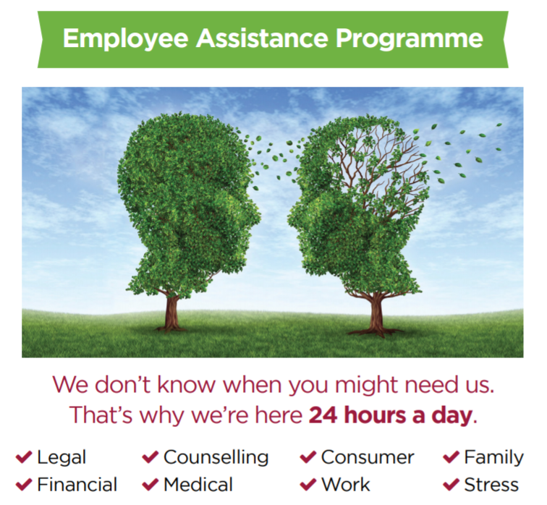
Toolkit & Ideas to help develop Personal Resilience Strategies
Everyone is an individual. There is no single solution. What will work for one person may not work for another person.
Use this section to help you find more information / options to explore to develop your personal resilience strategies based around your specific needs.
LIVING CONDITIONS
Crowded Households / Multigeneration Household Follow current government advice in this area https://www.gov.uk/government/publications/staying-alert-and-safe-social-distancing Consider changes you can make to reduce the risk and practice good hygiene and social distancing. Living with Vulnerable Persons / Shielding Persons Follow current government advice in this area https://www.gov.uk/government/publications/guidance-on-shielding-and-protecting-extremely-vulnerable-persons-from-covid-19
TRANSPORTATION
Wear face coverings if using public transport or taxis for travel purposes, if going through or visiting hospital sites. To help keep you safe, local Facilities hold a supply of face coverings available for colleagues who require these to get to / from work. A maximum of 2 face coverings will be issued per a person with instructions provided on use and laundry requirements. Discuss with your manager options around blended working and extended working hours as ways to reduce overall travel requirements.
MENTAL HEALTH
If living on own, consider creating a ‘support bubble’ to help combat loneliness choosing the right household to meet your needs https://www.gov.uk/guidance/meeting-people-from-outside-your-household Mind website has lots of useful tips on general mental health conditions and support but also COVID-19 related concerns https://www.mind.org.uk/information-support/coronavirus/ Notice your own signs and signals, create your own support plan. Connect with your MHWC at your centre, use the EAP if necessary. Five ways to wellbeing – Connect, Be Active, Take Notice Learn & Give https://www.mind.org.uk/workplace/mental-health-at-work/taking-care-of-yourself/five-ways-to-wellbeing/ Check out People First for tools, tips, resilience training, free apps and other offerings available at NHSBT such as virtual mindfulness sessions, stress masterclasses and wobble rooms http://nhsbandt.nhs.sitekit.net/copy-of-wellbeing/covid-19-wellbeing.htm
CARING RESPONSIBILITIES
Schooling / Childcare Follow current government advice on schooling https://www.gov.uk/coronavirus/education-and-childcare Discuss any concerns and possible short term flexible working options with your manager to help with practicalities. Supporting Vulnerable Persons / Other Dependents Follow government advice https://www.gov.uk/government/publications/coronavirus-outbreak-faqs-what-you-can-and-cant-do Continue social distancing and good respiratory hygiene.
Important Note:
Each nation of the UK may have different rules for face coverings, support bubbles, shielding. Ensure you are familiar with these based on where you live.

